Slide 1


Influencing Trends in NIPS
VISHWAKARMA INSTITUTE OF TECHNOLOGY
Presented by,
Akshay M. Lunawat 04 TY-D
Shreyas D. Sawai 52 TY-D
Jhanvi M. Bhatia 07 TY-C
Sairaj V. Nanaware 17 TY-D
Guided by: Prof. Swapnil Jawahire

Slide 2

CONTENTS
VISION
OBJECTIVES
LITERATURE SURVEY
SYSTEM ARCHITECTURE
COMPONENTS REQUIRED
METHODOLOGIES
Results
CONCLUSION

Slide 3
PROBLEM STATEMENT
TO CREATE A SYSTEM WHICH FINDS OUT TRENDING TOPICS IN RESEARCH PAPERS PROVIDED BY NIPS AND PROVIDE RECOMMENDATIONS UPON USERS INTEREST.
TY-D

Slide 4
VISION
The vision of our project is to carry out a review of the papers accepted at NIPS in the 1987-2017 decade.
Analyze and characterize the topics and trends in technology.
Identify challenges for the evolution of the area in the near future.

Slide 5

OBJECTIVES
Loading the NIPS papers.
Preparing the data for analysis.
Preprocessing the text data.
A word cloud to visualize the preprocessed text data.
Prepare the text for LDA analysis.
Analysing trends with LDA

Slide 6
LITERATURE SURVEY
SR NO. | TITLE | YEAR | AUTHOR | DESCRIPTION
1. | Sensing trending topics in Twitter. | 2013 | Luca Maria Aiello et.al | Novel techniques are best for heterogeneous and NLP are best for homogenous data.
2. | Popular Research Topics in Marketing Journals. | 2014 | Yung-Jan Cho et.al | Focus on quality of data to get more accurate result.
3. | Natural Language Processing – A solution for knowledge extraction from patent unstructured data | 2014 | Achille Souilia et.al | This paper analyzes dataset and maintain the count of keywords to predict the trending patent projects.
4. | Topic discovery and future trend forecasting for texts | 2016 | Jose L. Hurtado et.al | This paper describes methods to find out future trends from a given set of document.
5. | Using NLP on news headlines to predict index trends | 2018 | Marc Velay et.al | This paper predicts trends from news headlines by using Natural Language Processing

Slide 7
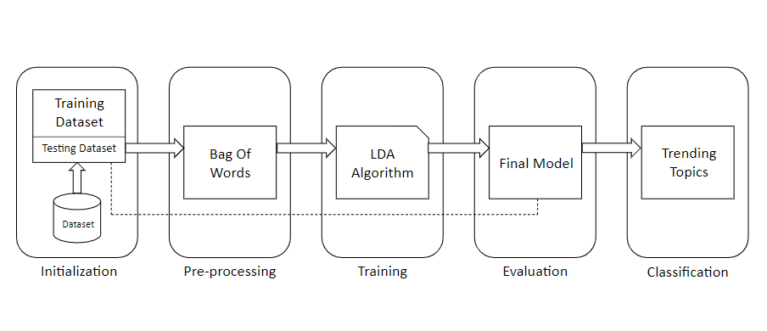
SYSTEM ARCHITECTURE

Slide 8
METHODOLOGIES
Data Pre-processing
Machine Learning Model : Latent Dirichlet Allocation(LDA)

Slide 9
Latent Dirichlet Allocation
Latent Dirichlet allocation (LDA) is a generative statistical model that allows sets of observations to be explained why some parts of the data are similar.
For example, if observations are words collected into documents, it posits that each document is a mixture of a small number of topics and that each word's presence is attributable to one of the document's topics.

Slide 10
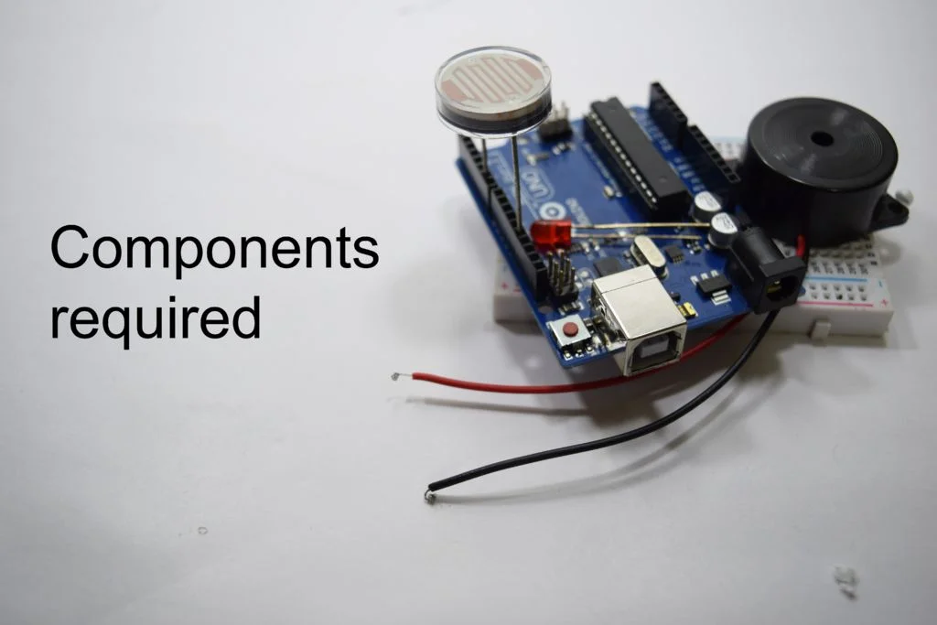
COMPONENTS REQUIRED
Hardware Requirement:
C.P.U – 2 cores
RAM - 1,536 MB
C.P.U frequency - 2.8GHz
Space – 100GB
Software Requirement:
1. Python 3.5
2. Jupiter Notebook

Slide 11
Results
Topic #0:
optimization efficient variational brain kernels nonlinear model generalized adversarial estimating
Topic #1:
learning model visual probabilistic recognition structured using high multiple based
Topic #2:
inference markov algorithm functions regularization learning hidden submodular models regularized
Topic #3:
learning clustering image gradient using adaptive descent generative convolutional framework
Topic #4:
classification learning method graph convergence machine complexity propagation based matching
Topic #5:
stochastic analysis learning optimal online linear data algorithms robust approach

Slide 12
CONCLUSION
We have developed a system which discovers future trends for NIPS using the title of a paper.
To discover future trends, we removed stop words and have done tokenization.
The tokenized data will then be given as input to the LDA model which is the best model for discovering the most frequently occurred words.

Slide 13

THANK YOU !
ANY DOUBTS ?

